Slide 1
FaceTime With Chat Application
Group Partners :-
Mustafa Hasnain 10709
Omer Khan 10619

Slide 2
Libraries which are used to build this Project
Express
ejs
Peer
Peer.js
Socket.io
uuid

Slide 3

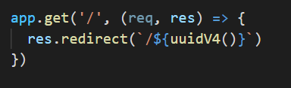
This unique key is generating because of the function below

Slide 4
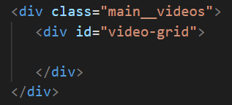
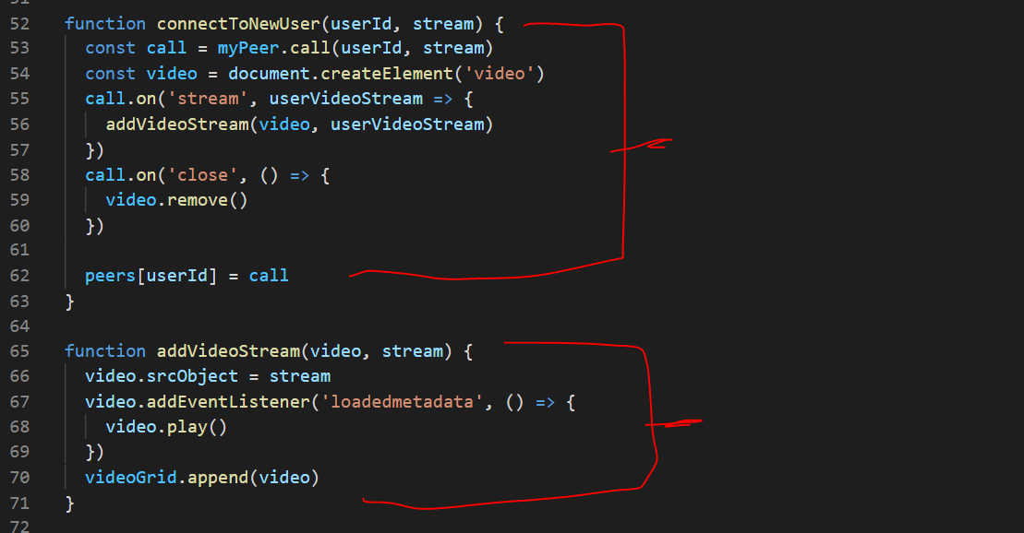
To get video from client
To display that video on Screen

Slide 5
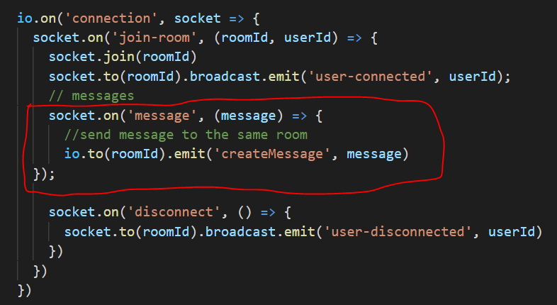
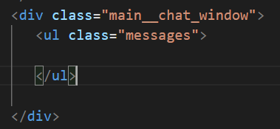
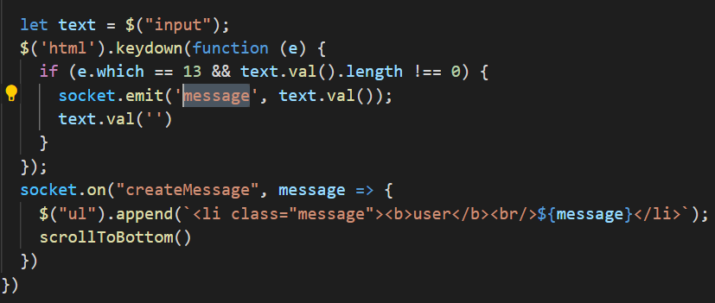
Chat Functionality

Slide 6
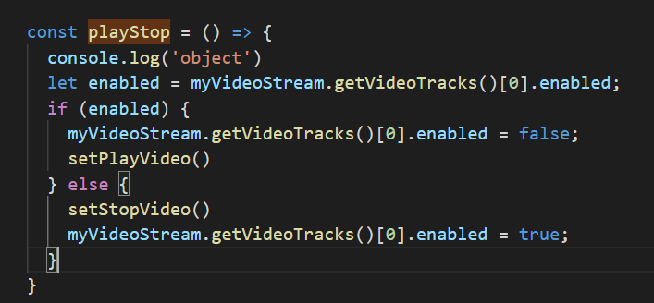

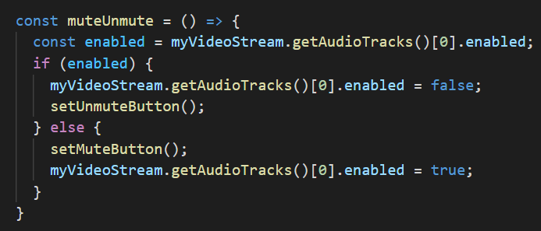


Slide 7
Special thanks to Web Simplified for video sharing only https://www.youtube.com/watch?v=DvlyzDZDEq4

